Slide 1
NONPROFIT INFRASTRUCTURE GRANT PROGRAM

Slide 2
BACKGROUND ON THE PROGRAM
Colorado House Bill 22-1356 was signed into law on 6/3/22 and created the small community-based non-profit grant program. This initiative invests dollars from the American Rescue Plan Act (ARPA) by providing grants to small community-based NPOs for infrastructure funding to help mitigate the financial hardships brought on by COVID-19.
8 Regional Access Partners (RAPs) have been selected to work with DOLA to administer grants of up to $100,000 to small, community-based NPOs across Colorado.
Total Available Funding: $33,100,000

Slide 3
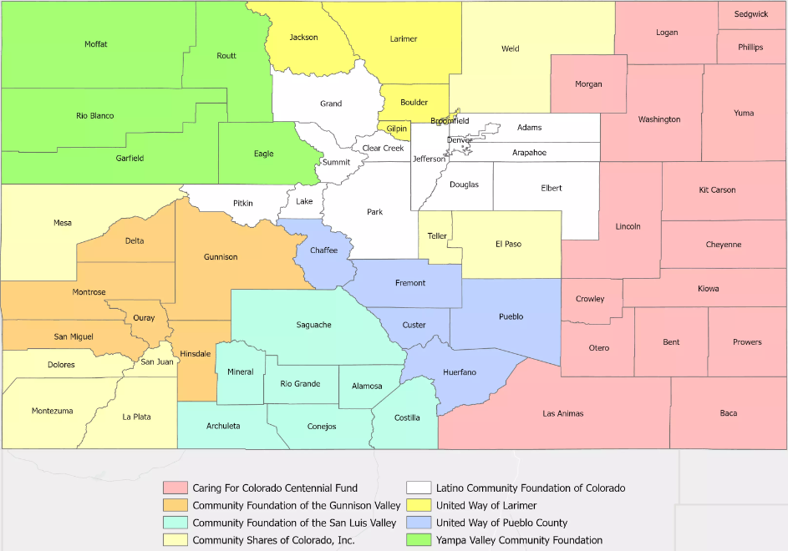
RAP COVERAGE
UWLC is serving as RAP for the following counties:
Larimer
Jackson
Boulder
Gilpin
Broomfield

Slide 4
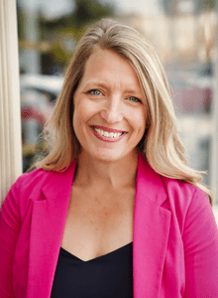
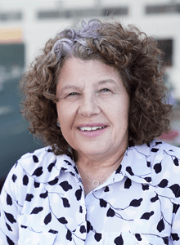
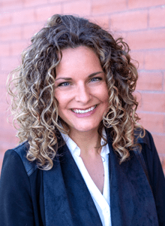
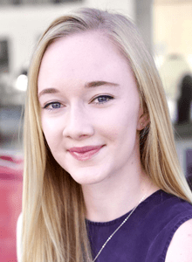
UNITED WAY OF LARIMER COUNTY TEAM
Deirdre Sullivan
(President and CEO)
Diane Hathaway
(Chief Financial Officer)
Christina Cooper
(VP of Resource Development)
Lauren Leary
(VP of Community Impact)
Maria Byers-Alexander
(Community Impact Manager)

Slide 5
INTENTIONS BEHIND THE FUNDING
Funding goal: To provide flexible COVID relief funding to small agencies who serve communities which have been historically underrepresented, underserved, or under-resourced.
Work of the Stakeholder Group (Creators of the legislation and Regional Access Partners)
Develop streamlined application and review documents
Provide applicants with consistent information and technical assistance
Lean on geographic/community expertise held by each RAP

Slide 6
WHO SHOULD APPLY
Budget:
Annual budgets between $150,000 and $2,000,000 (Can be a combined budget for non 501(C)3’s that are utilizing a Fiscal Sponsor)
COVID Impact:
Prove that they have been impacted or disproportionately impacted by COVID-19.
Quality Services:
Must have a track record of providing effective, culturally appropriate, and relevant programs and services

Slide 7
WHO SHOULD APPLY cont.
Populations served:
Programming is intended for communities who have historically been underrepresented, underserved, or under-resourced in Colorado including communities that hold the following identities: LGBT, BIPOC, Women, Gender non-conforming, Disability/neurodiversity, Low Income, Immigrant/Refugee, and Rural
Staff and Board Representation/Location:
The governing bodies and staff of these organizations must consist of a majority of residents who live in the communities they serve, hold identities of the communities that they serve, and have their main offices in one of the communities that they serve.
Services:
Health Equity | Workforce Development | Community Economic Development | Early Childhood Care | Education Support | Housing | Food Justice | or other community identified need

Slide 8
ELIGIBLE ENTITIES FOR FUNDING
Nonprofit Organization: A small community-based nonprofit organization that is a tax-exempt charitable or social welfare organization operating under a 501(c)(3) that has been impacted or disproportionately impacted by the Covid-19 public health emergency.
Fiscal Agent: A tax-exempt charitable organization or social welfare organization operating under a 501(c)(3) that has an arrangement with a small community-based nonprofit organization (NPO) that may or may not have its own tax-exempt status.
Fiscal Sponsor: A tax-exempt charitable or social welfare group operating under a 501(c)(3) that has an arrangement with small community-based groups (SCBG) that are not registered NPOs.

Slide 9
USE OF FUNDS
Nonprofit organizations may use grant funds toward things like:
Strategic planning and organizational development
Professional development for staff and board
Research
Data technology, data collection and/or technology infrastructure
Marketing and communications
Existing program expansion, development or evaluation
NPI Grant funds cannot be used toward programming or capital improvements, including:
Real estate or land acquisition
Building construction, renovation or improvement
Payment of debt
Advocacy or lobbying
Organizing
Endowments or reserves

Slide 10
REPORTING REQUIREMENTS
All grant recipients will be required to submit back up documentation on all expenses on a quarterly basis

Slide 11
TIMELINE
Application Period
July 5, 2023-August 31, 2023
RAP Award recommendations to DOLA
November 1, 2023
Award notice, Contract Execution, and first payment
December 15, 2023-January 31, 2024
All funding must be spent
December 30, 2026

Slide 12
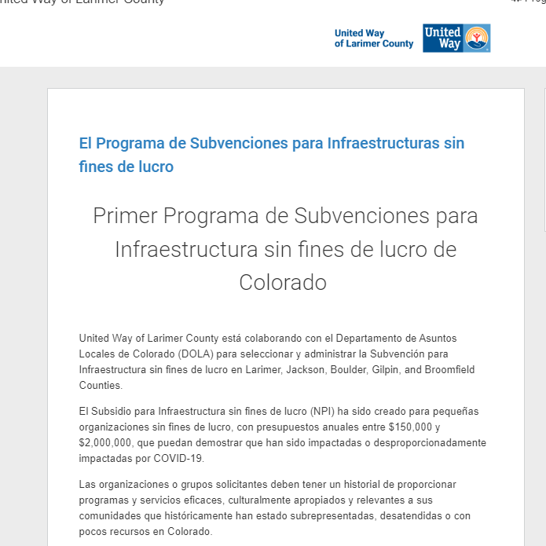
IMPORTANT LINKS
All applications (Nonprofit, Fiscal Agent, and Fiscal Sponsor) will be available on our Grant Platform: Survey Monkey Apply. The link to this platform can be found on our grant process page at https://uwaylc.org/grant-process/

Slide 13
CONTACT INFORMATION
Program Administrator: Maria Byers-Alexander
Contact information:
Email: mbyers-alexander@uwaylc.org
Phone: 970-407-7019
Calendly Page: https://calendly.com/mbyers-alexander

